Slide 1
Chapter 20
Encouraging Individuation
Jeff Clowes IT Network Administration
Jonathon Jones Pre-Employment Electrical
Rebecca Derrah Social Services

Slide 2

MacGyver Challenge

Slide 3
A CAT IS STUCK IN A TREE!
The Saint John River Flood waters are rising
You must save the cat and help get it back to his owner!!
You Must use all three of the following objects during your rescue attempt.
Pencil
Banana
hat

Slide 4
Agenda
3 Strategies for Encouraging Individuation
Activity
Question Period
Reflection/Closing

Slide 5
Chapter 20
Encouraging Individuation
Jonathon
Jeff
Rebecca
Becoming Aware of Collectives
Separating From Collectives
Joining New Collectives

Slide 6
Becoming Aware
of Collectives
Grouping
Stories
interviews

Slide 7

Becoming aware of Collectives
Grouping
Trades and Service
Identification with department/staff

Slide 8





STORIES
-Another Perspective
NBCC recipient Training for the Trades
Career progression always supported by NBCC
NBCC Instructor Training for the Trades

Slide 9
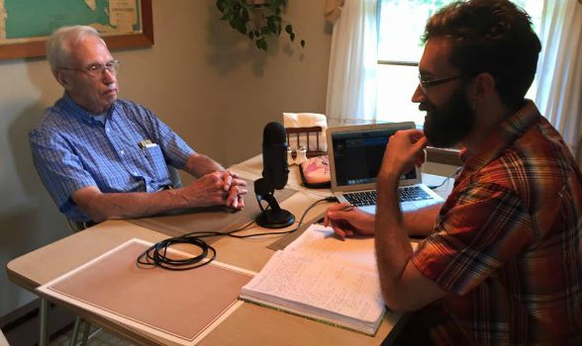
Becoming aware of Collectives
Interviews
-Another perspective

Slide 10
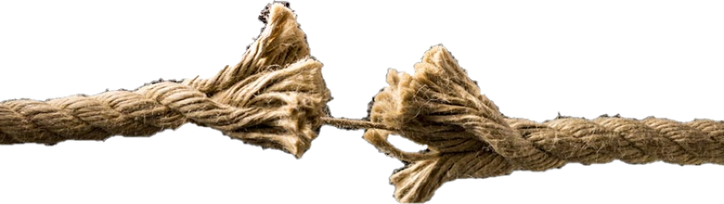
Separation from groups
2 Factors we can assist in:
  Gaining an understanding of the collectives they’ve come from
  Help people move away from those collectives that no longer serve them

Slide 11
Differentiation
Understanding collectives we’ve left:
  Some exercises we can use:
    Interview someone we’ve known a long time
    Examining souvenirs, photos and keepsakes from the past
    Have learners identify something they’ve left behind

Slide 12
Differentiation
Moving away from Collectives:
  Some exercises:
    Ask an individual to defend a point of view they would normally be against in a debate
    Role play a situation where a person takes on a role opposite one they would normally hold
  Look at social or professionally accepted perspectives with a critical eye

Slide 13
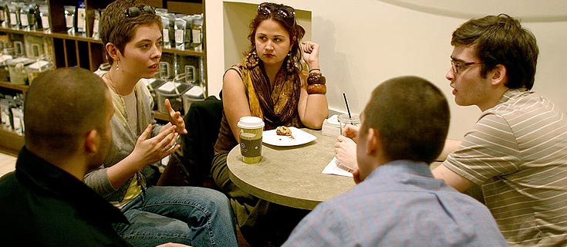
Joining New Collectives
Individuation is an opportunity to become a part of new collectives in a more meaningful way

Slide 14
NBCC
Rebecca
NBCC Learner
Woodstock
IDP
IDP
CLASS
?
Social Services
Department

Slide 15
Helping Learners Become a part of a new collective
Encourage building relationships, networking and study groups within your classroom
Introduce your learners to groups, organizations or clubs where they can meet like minded individuals
Encourage them to connect with others in their field of choice
Promote Volunteer work related to their interests
Motivate them to continue their journey of self discovery

Slide 16
ACTIVITY

Slide 17
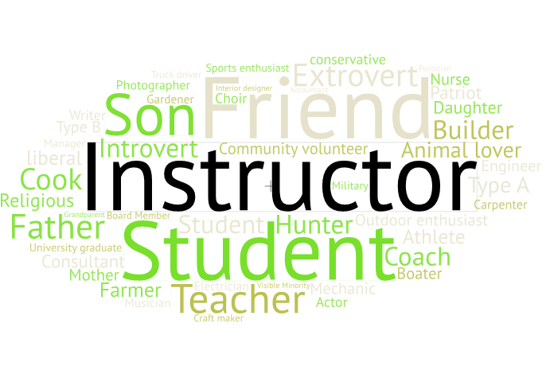

Slide 18


Slide 19
